Slide 1
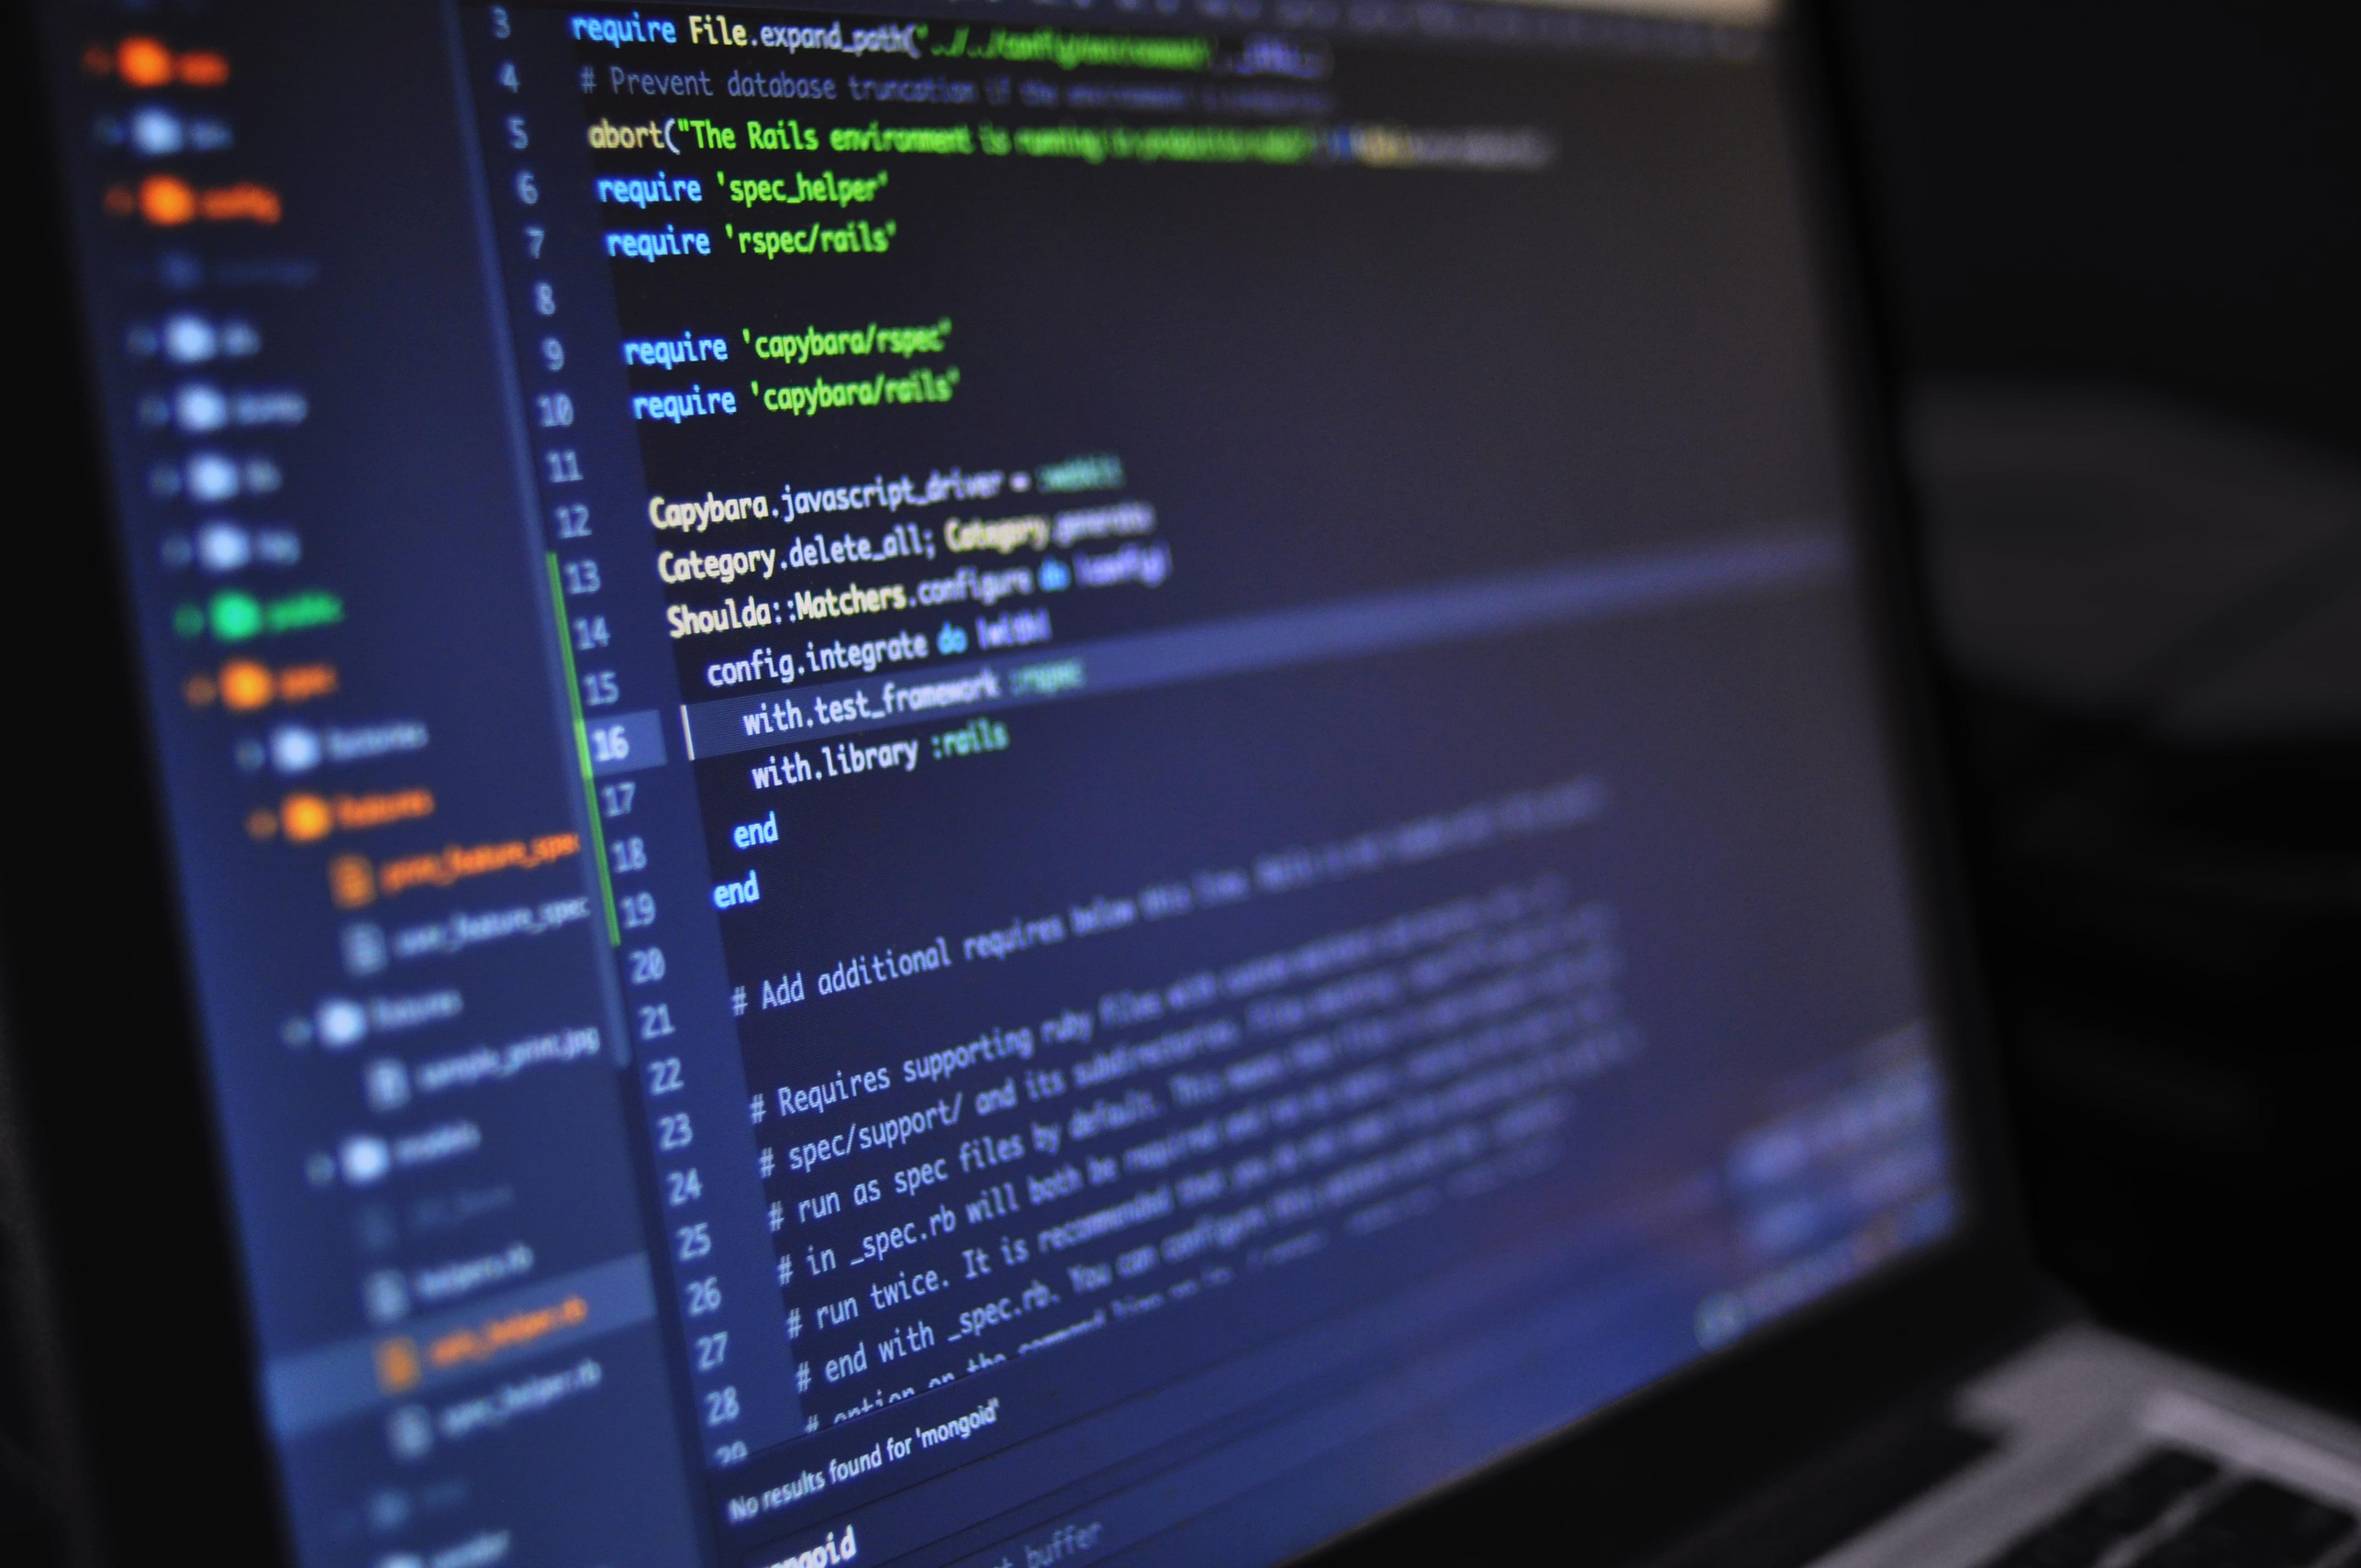



HACK4HEALTH
Gen AI Hackathon
Bridging Healthcare Communication Gaps

Slide 2


Members:
Team Name
01
01
Shashi Singh
Lakshya
02
Aditya Patel
Team’s Problem Statement
Bridging Healthcare Communication Gaps
03
Vidhi Jain
04
Mitul Khanna

Slide 3

Idea Briefing:
Understanding medical reports and related information can often be confusing for non-medical individuals. Many patients receive medical imaging or reports but struggle to comprehend the meaning behind them without waiting for a consultation with a doctor. This gap leads to delays, anxiety, and miscommunication about personal health.
Our project addresses this challenge by offering a straightforward solution: a user-friendly platform that provides simple, easy-to-understand insights into medical information for patients. While interpreting complex medical imaging with AI models isn't integrated at this stage, the application provides insights into basic health-related information uploaded by users.

Slide 4
Objective
The goal of our project is to simplify the understanding of medical insights by allowing users to upload medical reports or related files and receive clear, concise, and easy-to-read explanations. This app acts as a communication bridge between technical medical terms and layman’s language, empowering users to better understand their own medical data.

Slide 5
Tech stack
Frontend
Framework: Native Android Development
Programming Language: Java (as you're familiar with it).
UI Components: Android XML for layout design.
CameraX
Backend (Java)
The app leverages Java for its core logic, integrating CameraX for capturing images, processing them with Google ML Kit for analysis, and utilizing Jsoup to scrape relevant information from the web using CSS selectors for precise data extraction. This ensures efficient and seamless data flow in the application.

Slide 6
Tech stack
Google ML Kit
The app utilizes Google ML Kit to process and analyze images captured via CameraX. ML Kit provides on-device machine learning capabilities, allowing the app to extract text, recognize patterns, or perform image analysis efficiently and securely without requiring constant internet connectivity. This integration ensures fast and reliable processing of medical data directly within the app.

Slide 7
Problem and Solution
The Problem
Many of us have faced situations where we receive medical reports or images but are left clueless about what they mean until a doctor explains them.
Our Solution
To address this challenge, we’ve developed an innovative app that acts as a bridge, empowering users with basic insights into their medical images.

Slide 8
High Level Diagram
User Interaction:
User Device: The starting point where users interact with the app (capture/upload medical reports/images).

Slide 9
High Level Diagram
App Components:
CameraX Integration : Captures images
Google ML Kit : Processes the captured images (e.g., text extraction or analysis).
Logic Layer (Java) : Core logic that handles image processing results and prepares them for further operations.
Web Scraper (Jsoup) : Fetches relevant health information using CSS selectors from online medical sources.

Slide 10
Resources
developer.android.com - Android Docs
developers.google.com - Docs
Libraries and API’s
CameraX
Google ML Kit
Jsoup

Slide 11
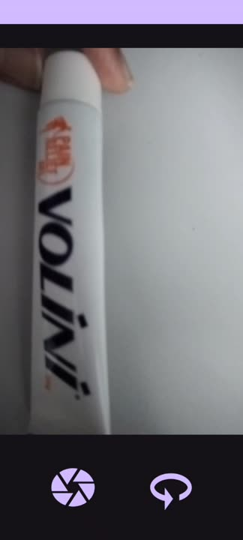

Slide 12



Thank you

Slide 13
Github Link
https://github.com/ShashiSingh8434/ImageTextRecognitionUsingMLKit_App

